Slide 1
Cloud Series AWS & Microservice
Rasim SEN

Slide 2
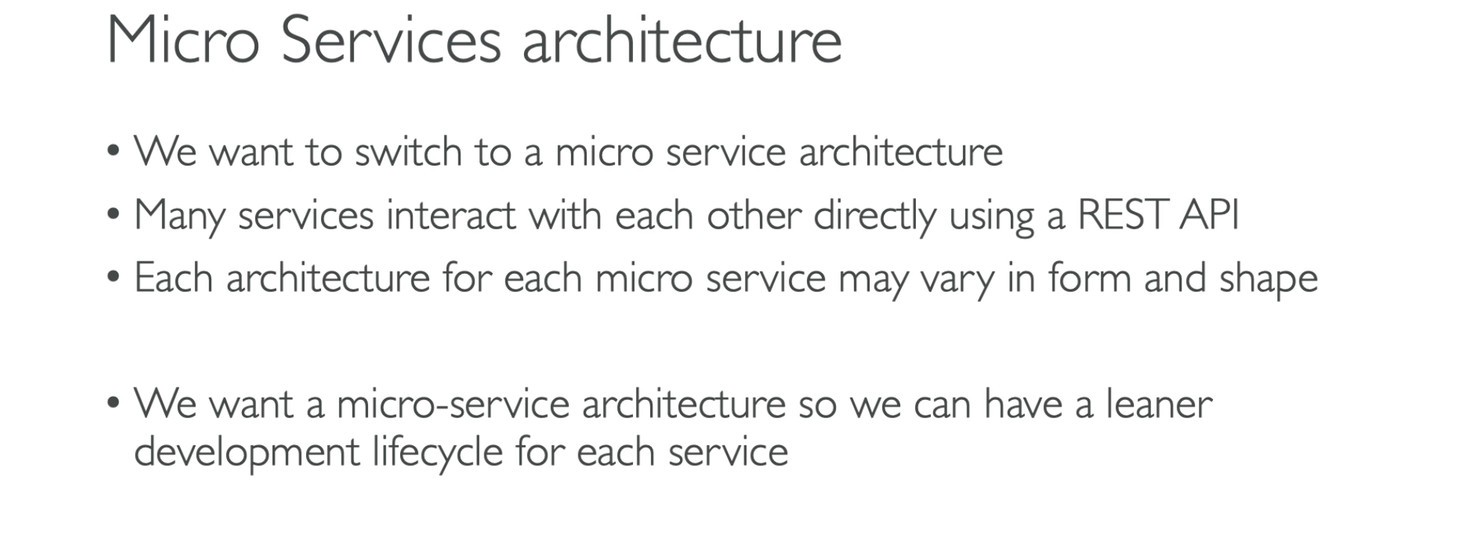

Slide 3
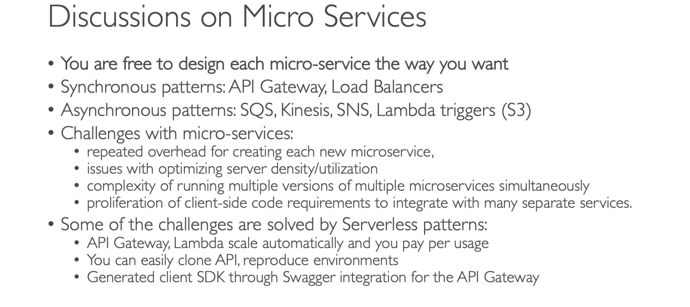

Slide 4
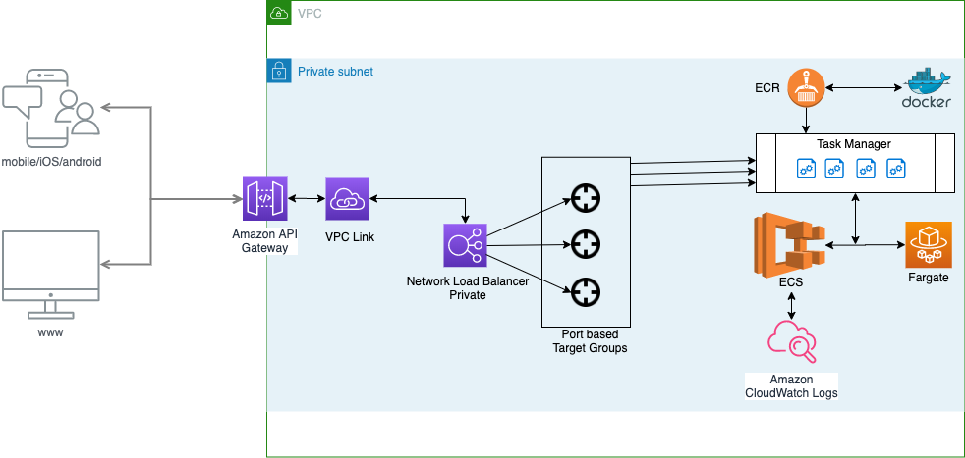
Architecturally what will we do ?

Slide 6
AWS Fargate
AWS Fargate is a serverless compute engine for containers that works with both Amazon Elastic Container Service (ECS) and Amazon Elastic Kubernetes Service (EKS). Fargate makes it easy for you to focus on building your applications. Fargate removes the need to provision and manage servers, lets you specify and pay for resources per application, and improves security through application isolation by design.
Benefits
Deploy and manage applications, not infrastructure
Right-sized resources with flexible pricing options
Secure isolation by design
Rich observability of applications

Slide 7
How ECS works on Fargate and EC2

Slide 8

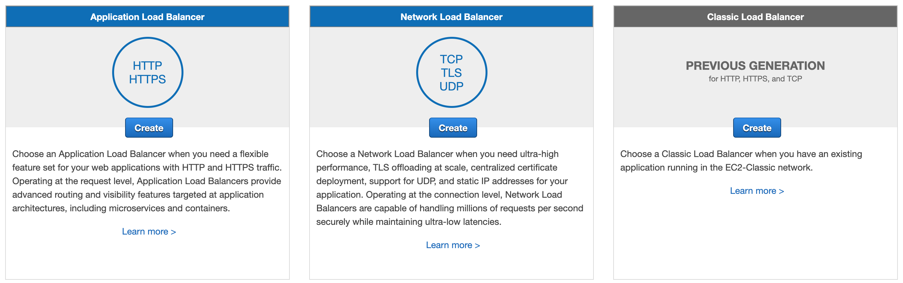
Elastic Load Balancer
CLB — Avoid, legacy
NLB — Layer 4, Static IPs
ALB — Layer 7, Flexible

Slide 9

Let’s start..

Slide 10
Using Amazon API Gateway with microservices deployed on Amazon ECS

Slide 11
Steps / Prerequisites
Setups
Node.js/NPM installation
Docker installation
AWS CLI installation
NodeJs – HelloWorld microservice
DockerFile – create, build, run
AWS steps:
VPC
Security Groups, Subnets
ELB – Elastic Load Balancer
Network Load Balancer(Private)
Target Group
Creating the Registry (ECR) and uploading the app image to it
Creating an environment with the AWS Management Console
Step 1: Creating a new task definition
Step 2: Creating a cluster
Step 3: Creating a service to run it
Configuring API Gateway
Step 1: Create an API
Step 2: Create Resources
Step 5: Deploy the API

Slide 12
Prerequisites
you’ll need the following:
Node and Npm → node –-version and npm --version
Basic knowledge of Node.js
Docker → docker –version
AWS account: Sign up for a free tier. There is a waiting period to verify your phone number and bank card. After this, you will have access to the console.
AWS CLI (You need Python installed)

Slide 13
Hello-world node.js application
Index.js
// create a new directory
mkdir hello-world-nodejs-app
// change to new directory
cd hello-world-nodejs-app
// Initialize npm
npm init -y
// install express
npm install express
// create an index.js file
touch index.js
const express = require('express')
const app = express()
app.get('/', (req, res) => {
res.send('Hello world from a Node.js app!')
})
app.listen(3000, () => {
console.log('Server is up on 3000')
})
Test : $ node index.js

Slide 14

One convenient way to run microservices is to deploy them as Docker containers. Docker containers are quick to provision, easily portable, and provide process isolation. Amazon Elastic Container Service (Amazon ECS) provides a highly scalable, high performance container management service. This service supports Docker containers and enables you to easily run microservices on a managed cluster of Amazon EC2 instances.

Slide 15
Dockerfile
FROM node:12-alpine
RUN mkdir -p /usr/src/app
WORKDIR /usr/src/app
COPY . .
RUN npm install
EXPOSE 3000
CMD [ "node", "index.js" ]

Slide 16
Building and running docker
docker build -t hello-world-nodejs-app . # building
docker images # list images
docker run -p 80:3000 {image-id}
http://localhost # test
docker container ls # running container
docker stop {container-id} # stop

Slide 17
Create Registry (ECR) and upload the app image to it
Amazon Elastic Container Registry (ECR) is a fully-managed Docker container registry that makes it easy for developers to store, manage, and deploy Docker container images. Amazon ECR is integrated with Amazon Elastic Container Service (ECS), simplifying your development to production workflow.
Steps:
Go to the AWS console and sign in.
Select the EC2 container service(ECS) and Get started
Go to AWS CLI and configure it
$ aws configure
Notes:
https://eu-west-2.console.aws.amazon.com/ecs/home?region=eu-west-2#/getStarted

Slide 18
$ aws configure
AWS Access Key ID [****************XDBQ]:
AWS Secret Access Key [****************oxPd]:
Default region name [eu-west-2]:
Default output format [None]:

Slide 19
..continue..
Go to AWS Console / ECR
Create a new repository and enter a name (preferably with the same container name as in your local dev environment for consistency).
Follow the 5 instructions from the AWS console for building, tagging, and pushing Docker images.

Slide 20
Create a new task definition
Tasks function like the docker run command of the Docker CLI but for multiple containers. They define:
Container images (to use)
Volumes (if any)
Networks Environment variables
Port mappings
From Task Definitions in the ECS dashboard, press on the Create new Task Definition (ECS) button

Slide 21
From Task Definitions in the ECS dashboard, press on the Create new Task Definition (ECS) button
Set a task name and use the following steps:
Add Container: hello-world-nodejs-app (the one we pushed).
Image: the URL to your container (copy from ECR image)
Soft limit: 512
Map 3023 (host) to 3000 (container) for sample-nodejs-app

Slide 22
Create a Cluster
A cluster is the place where AWS containers run. They use configurations similar to EC2 instances. Define the following:
Cluster name: hello-world-nodejs-app-cluster
EC2 instance type: t2.micro
Number of instances: 1
EBS storage: 22
Key pair: None
VPC: New
When the process is complete, you may choose to click on “View cluster.”

Slide 23
Create a service to run it
Go to Task Definition > click hello-world-nodejs-app > click on the latest revision.
Inside of the task definition, click on the actions dropdown and select Create service
Use the following:
Launch type: EC2
Service name: demo-nodejs-app-service
Number of tasks: 1
Skip through options and click Create service and View service.
You’ll see its status as PENDING. Give it a little time and it will indicate RUNNING.
Go to Cluster (through a link from the service we just created) > EC2 instances > Click on the container instance to reveal the public DNS.

Slide 24
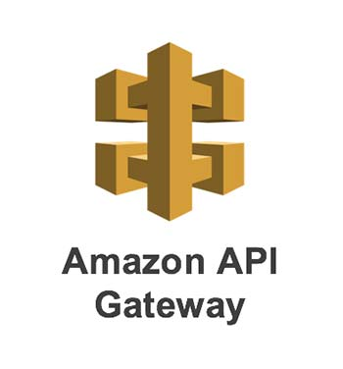
Microservices usually expose REST APIs for use in front ends, third-party applications, and other microservices.
A best practice is to manage these APIs with an API gateway.
This provides a unique entry point for all of your APIs and also eliminates the need to implement API-specific code for things like security, caching, throttling, and monitoring for each of your microservices.
You can implement this pattern in a few minutes using Amazon API Gateway. Amazon API Gateway is a fully managed service that makes it easy for developers to create, publish, maintain, monitor, and secure APIs at any scale.

Slide 26
https://www.freecodecamp.org/news/how-to-deploy-a-node-js-application-to-amazon-web-services-using-docker-81c2a2d7225b/
https://aws.amazon.com/blogs/compute/using-amazon-api-gateway-with-microservices-deployed-on-amazon-ecs/
https://www.dragonspears.com/blog/aws-container-orchestration-101-ecs-vs-fargate-vs-eks – ec2 vs fargate

Slide 27
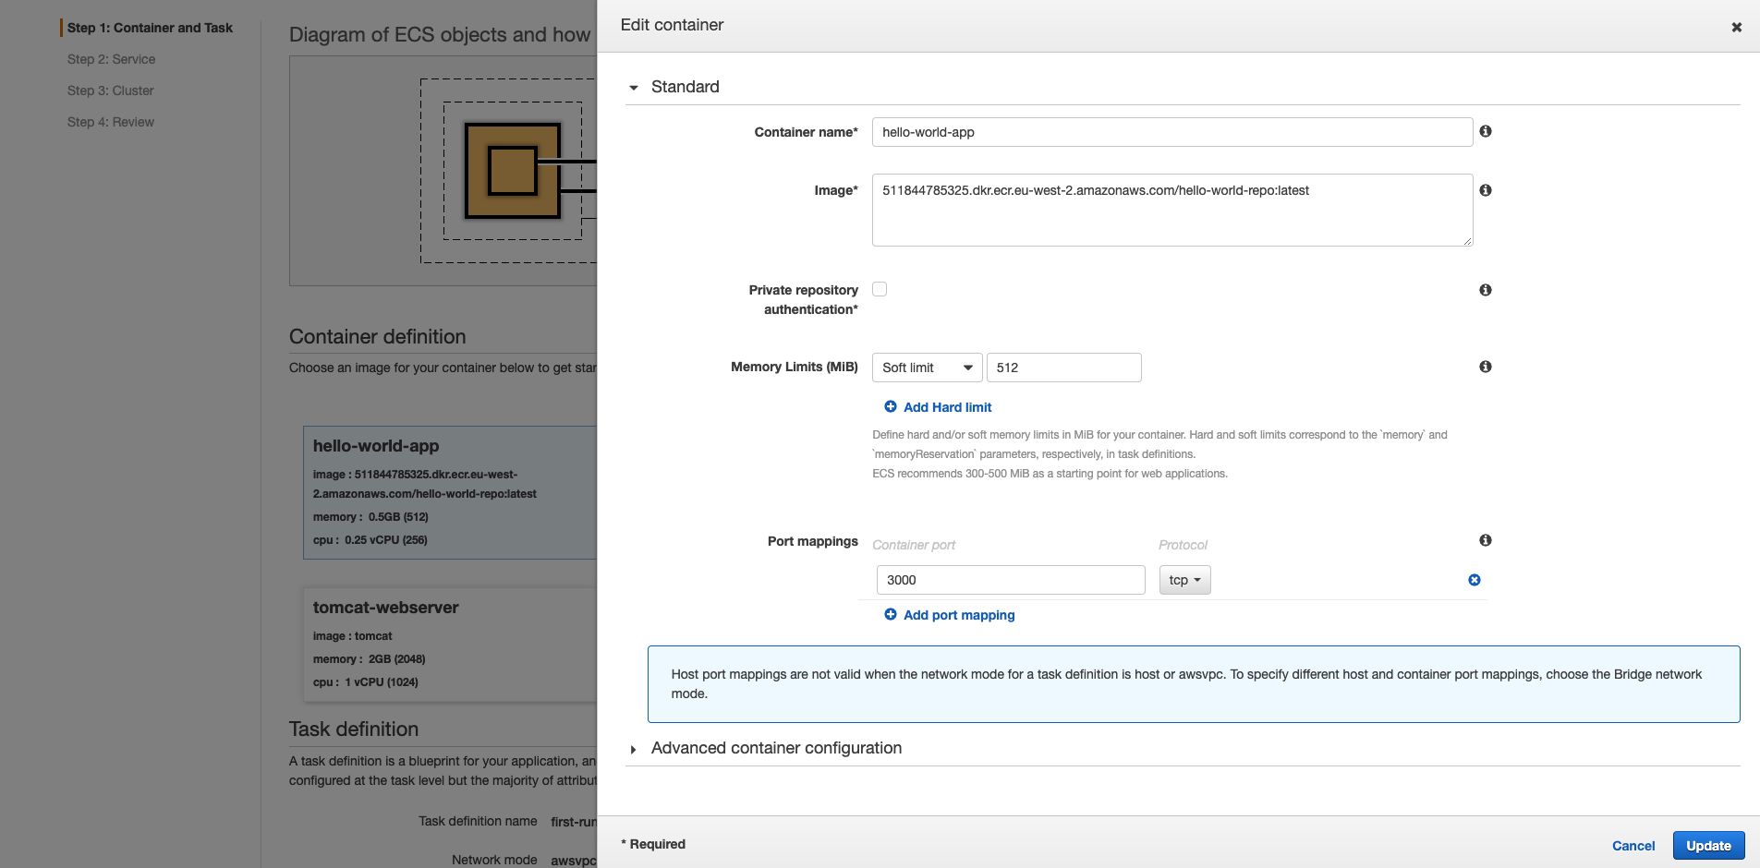
AWS – Demo Quide

Slide 28
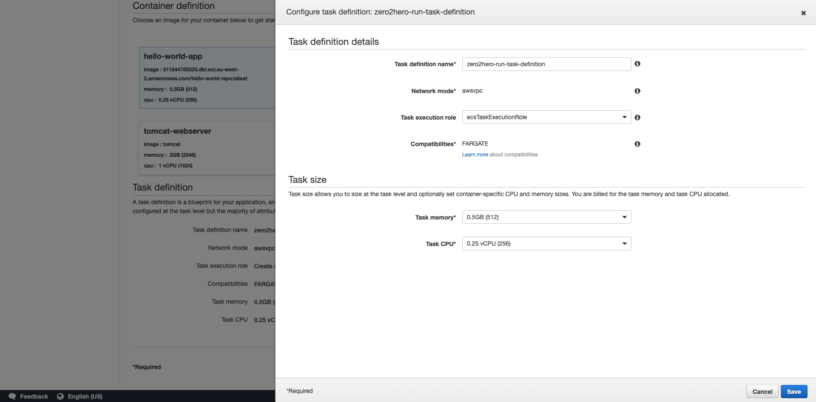
Task definition details

Slide 29
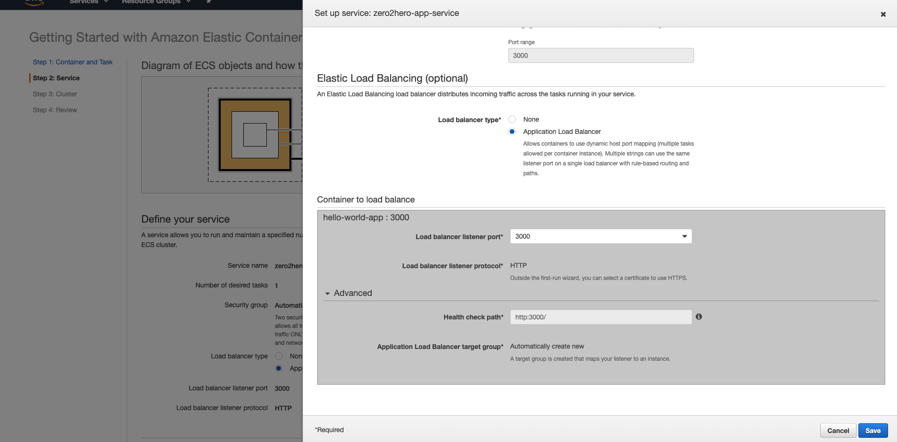
Service Definition

Slide 30
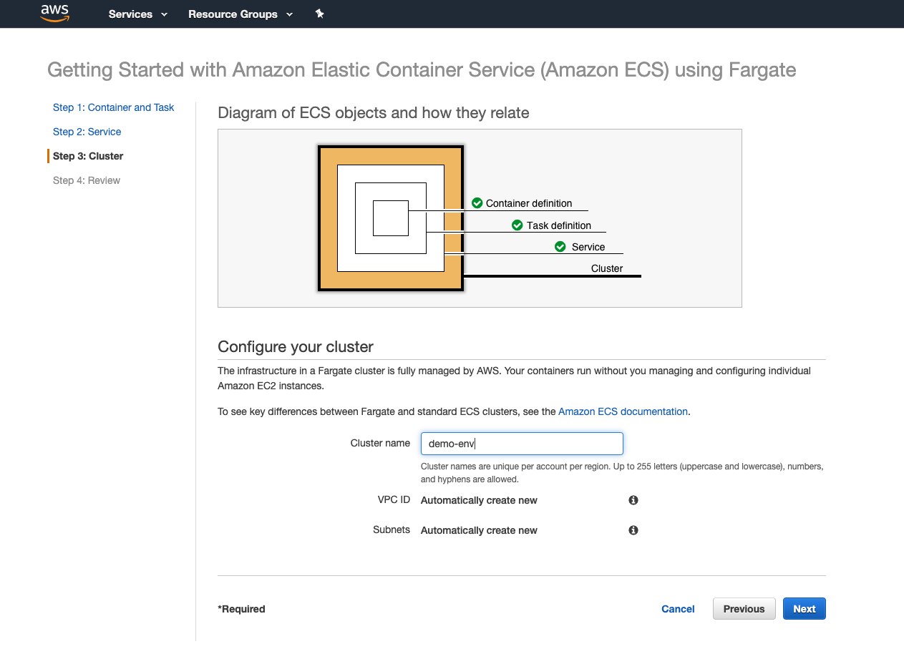
Cluster

Slide 31
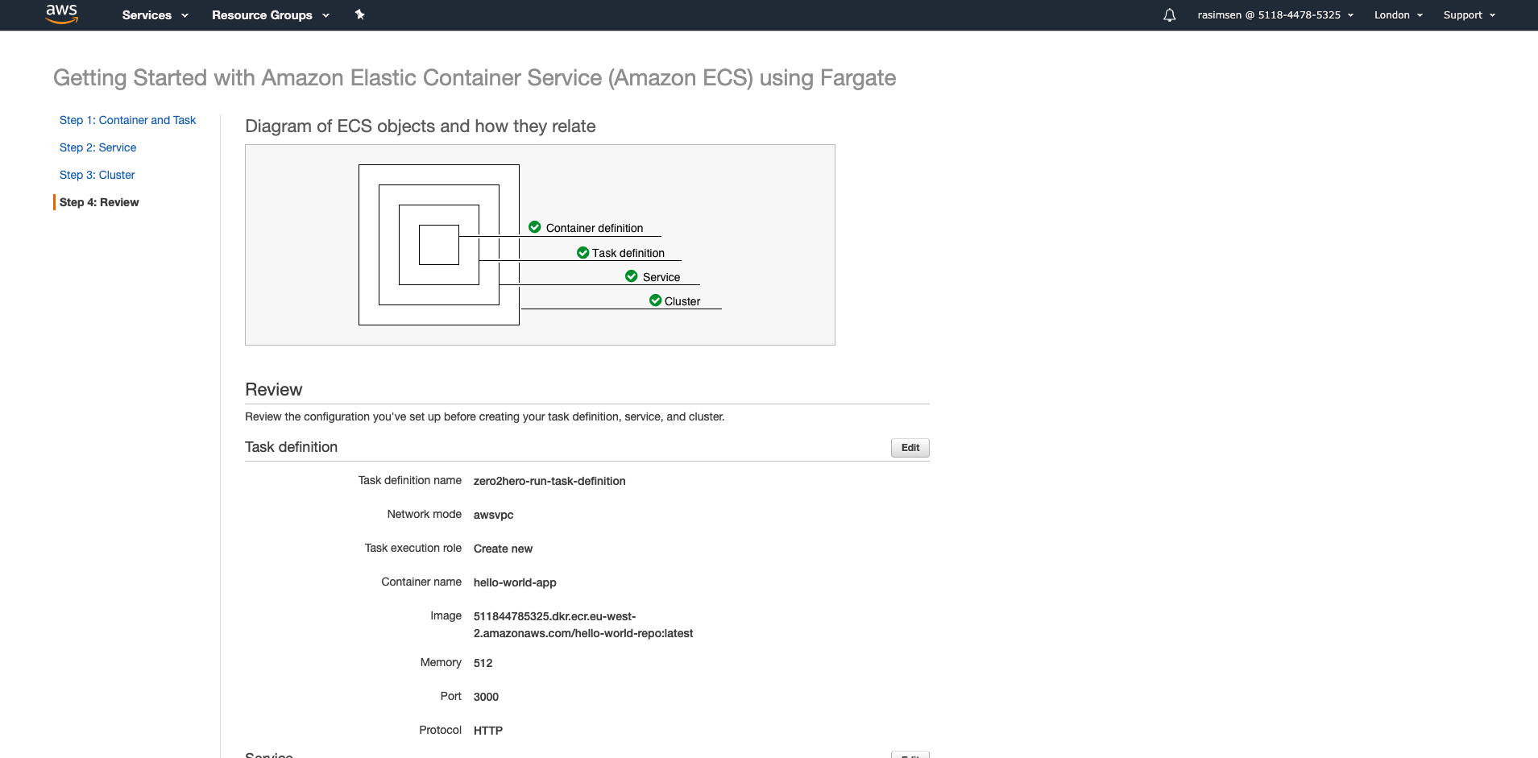
Review

Slide 32
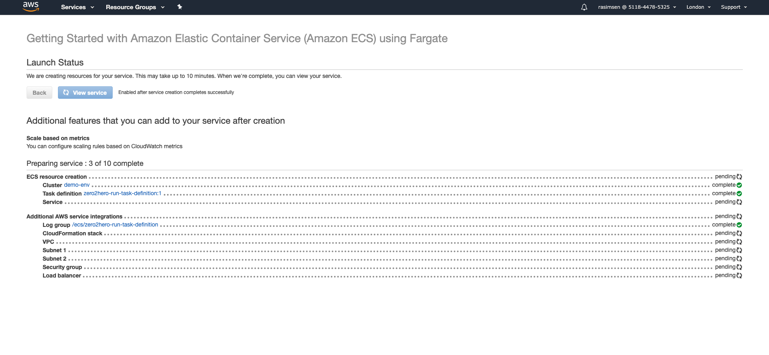
Launch Status

Slide 33
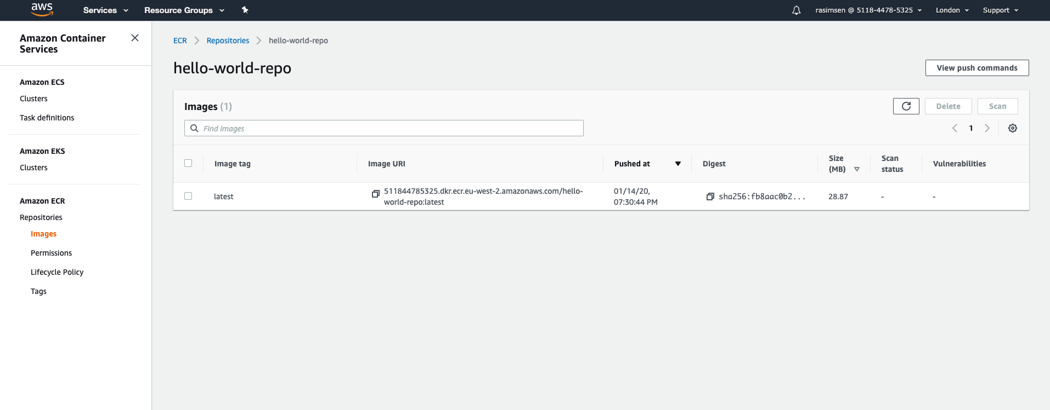
ECR

Slide 34
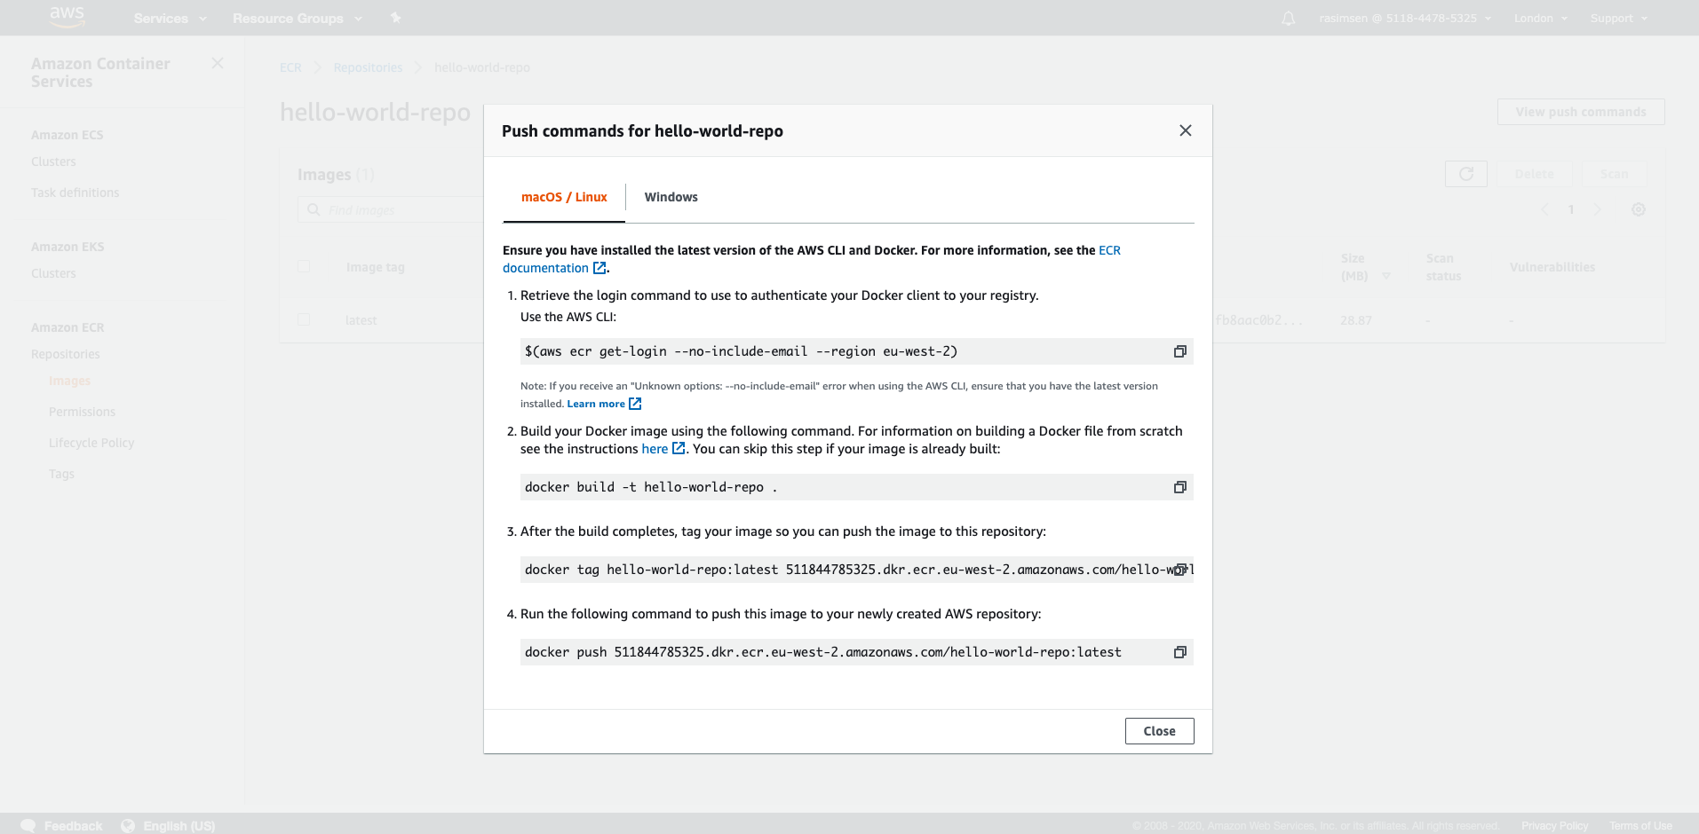
ECR
Please note: AWS updated AWS CLI tool, depending on it, some of the CLI commands has been changed!!

Slide 35
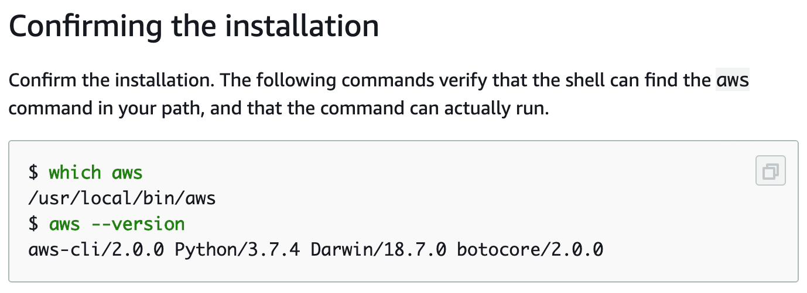
AWS CLI 2.0 installation
To upgrade CLI : https://docs.aws.amazon.com/cli/latest/userguide/install-cliv2-mac.html
Notes:
which aws
aws --version

Slide 36
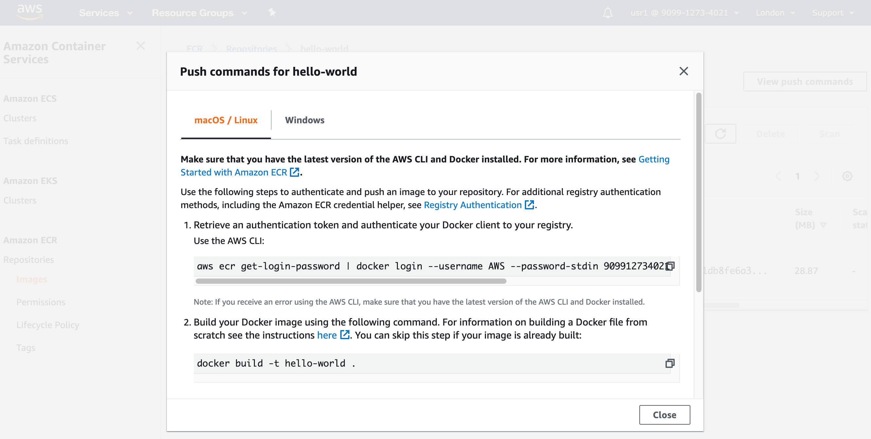
ECR commands like below regarding to AWS CLI 2

Slide 37
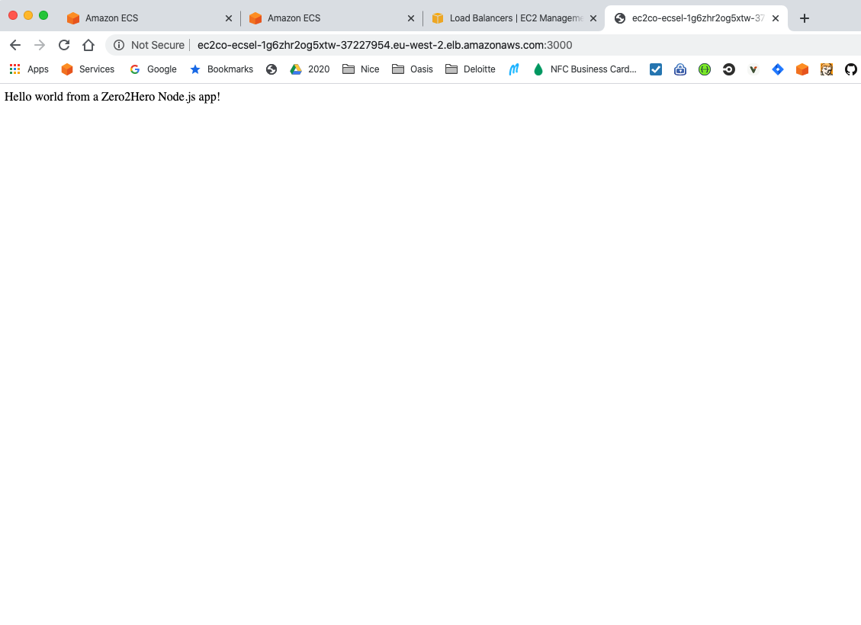
Test

Slide 38
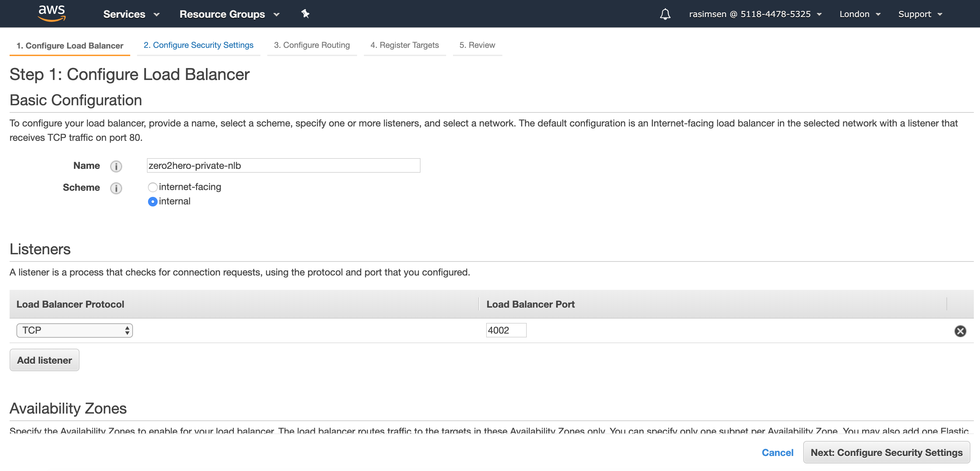
Private NLB

Slide 39
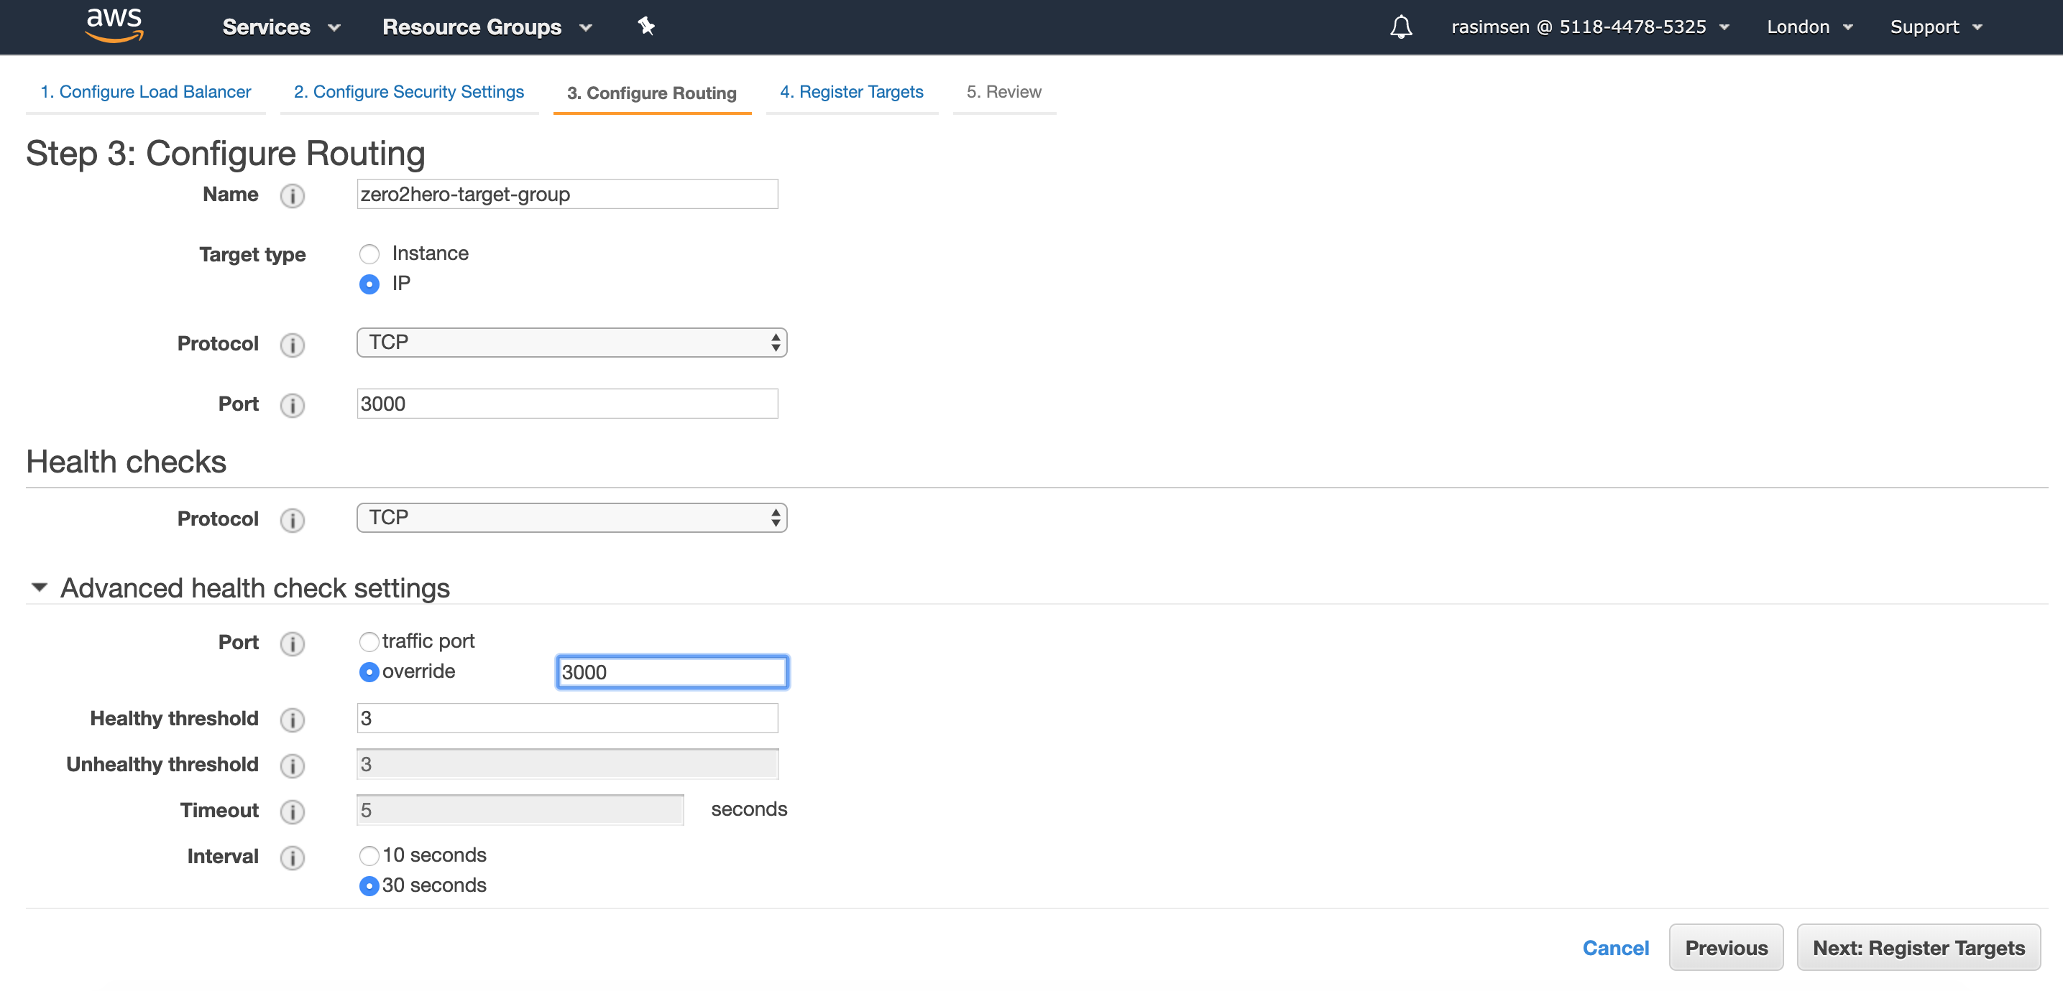
Target group - Routing

Slide 40
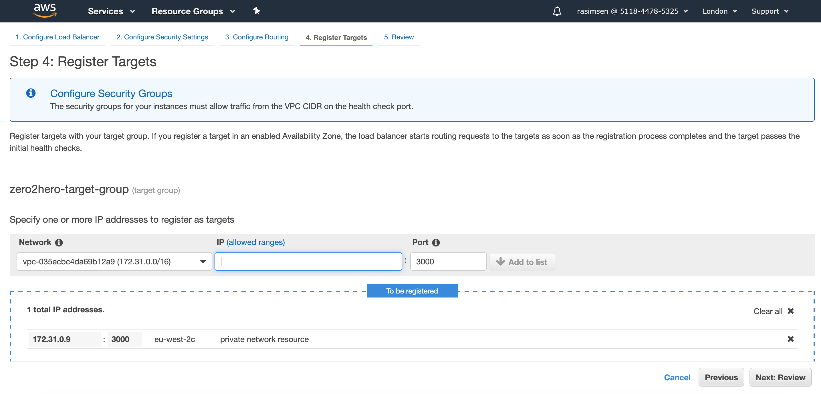
Register Target

Slide 41
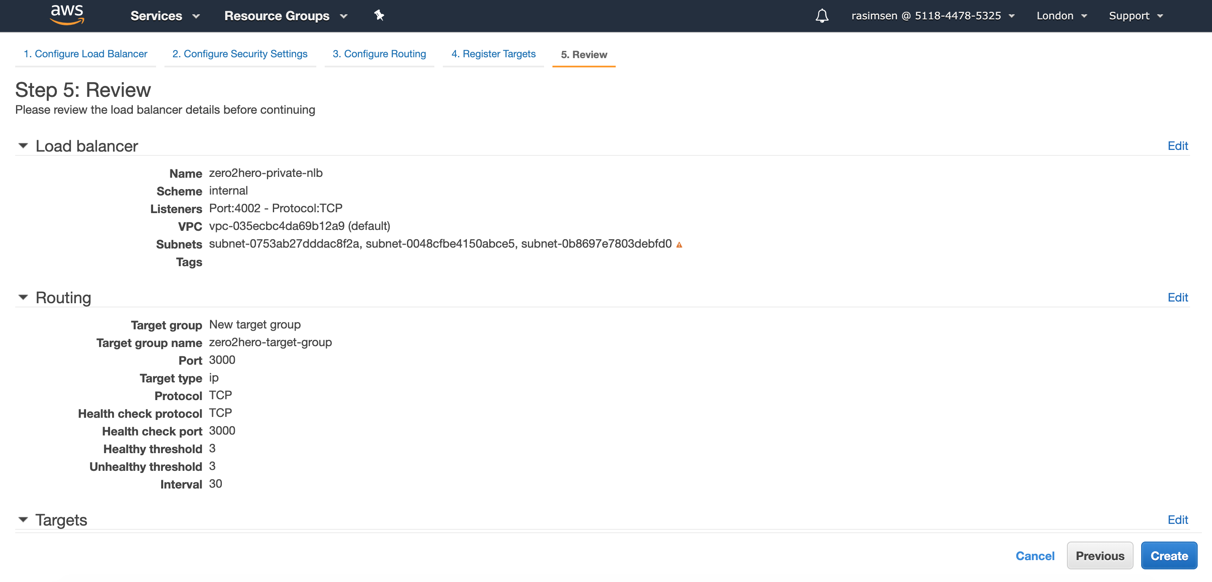
Review

Slide 42
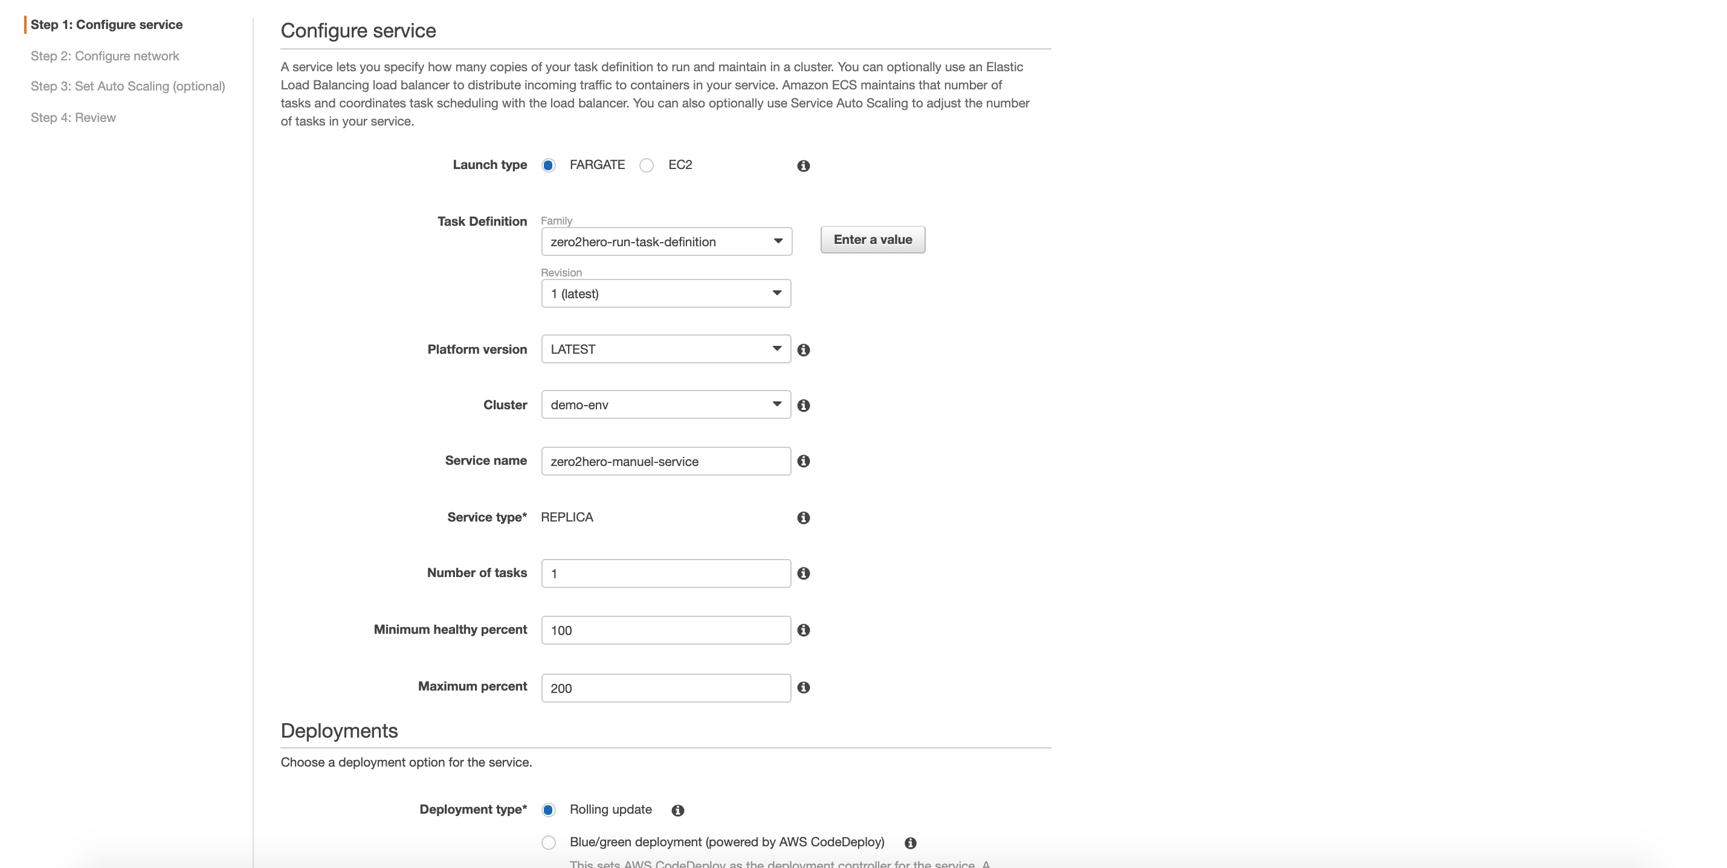
ECS

Slide 43
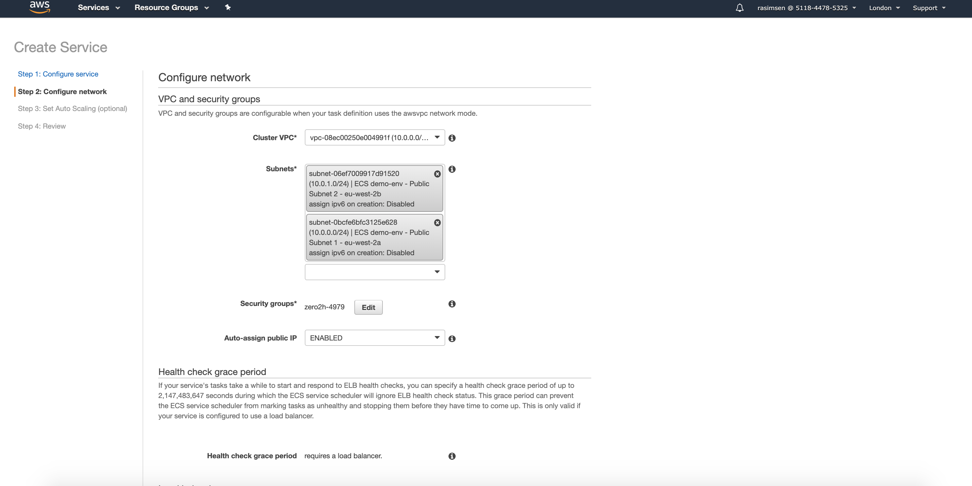
Configure Network

Slide 44
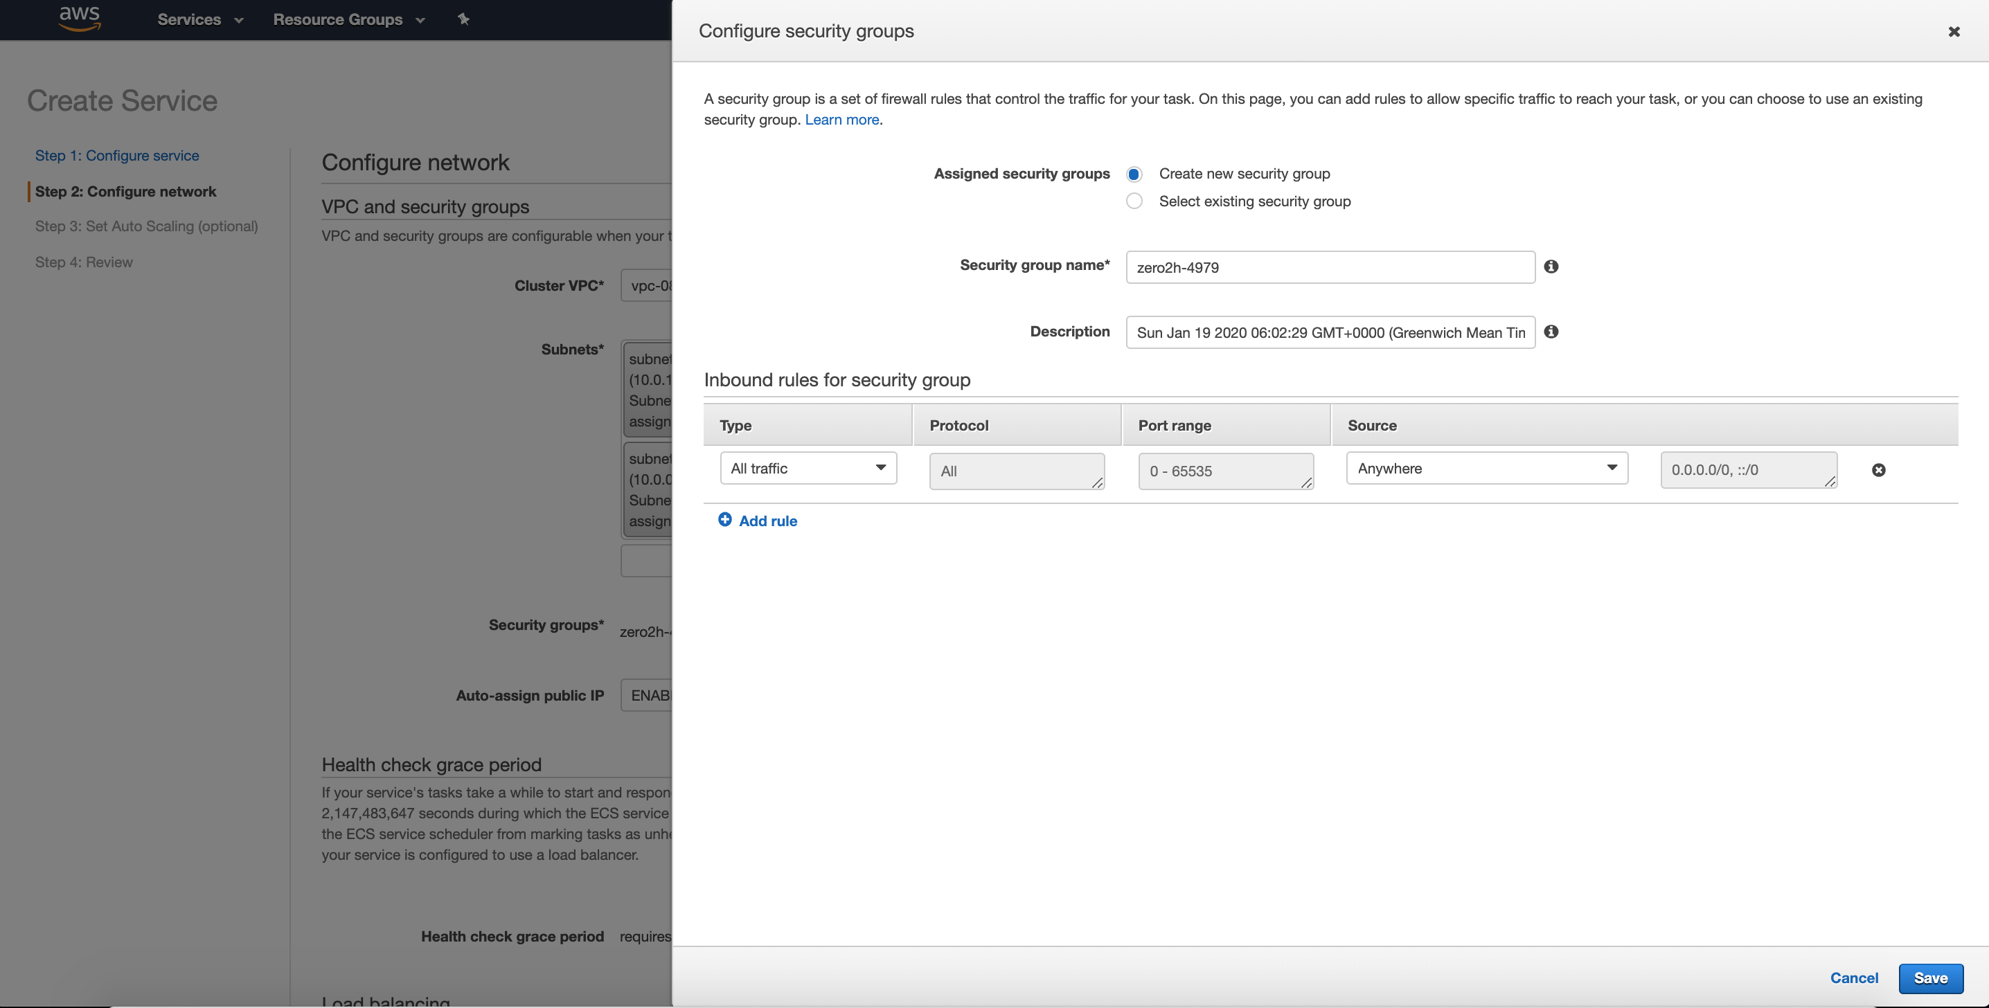
Configure security groups

Slide 45
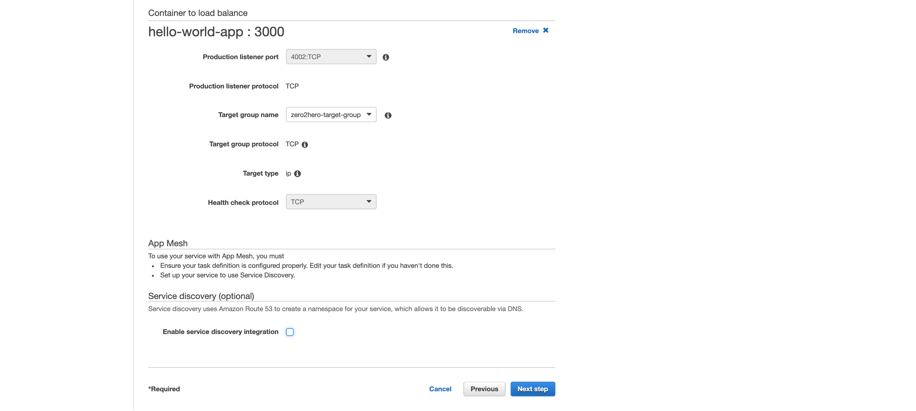

Slide 46
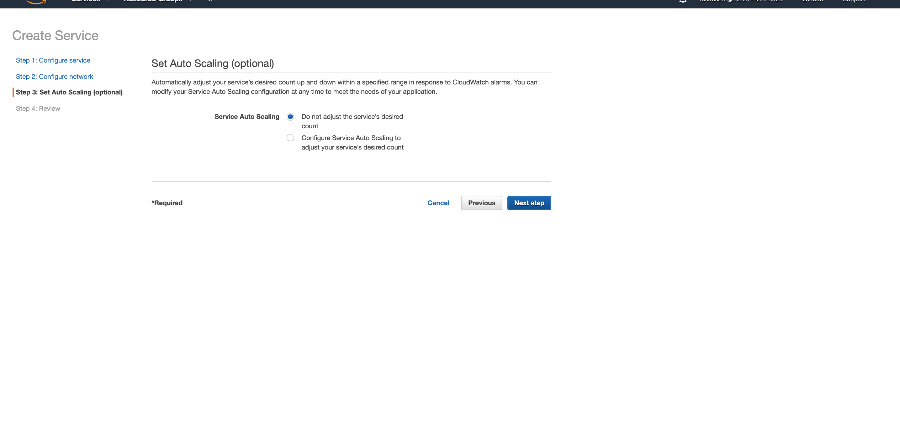

Slide 47
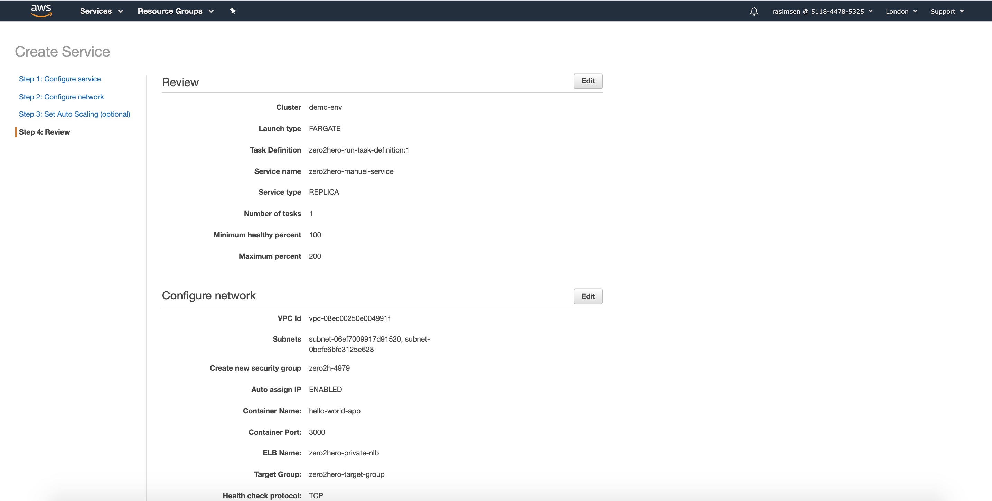
Review

Slide 48
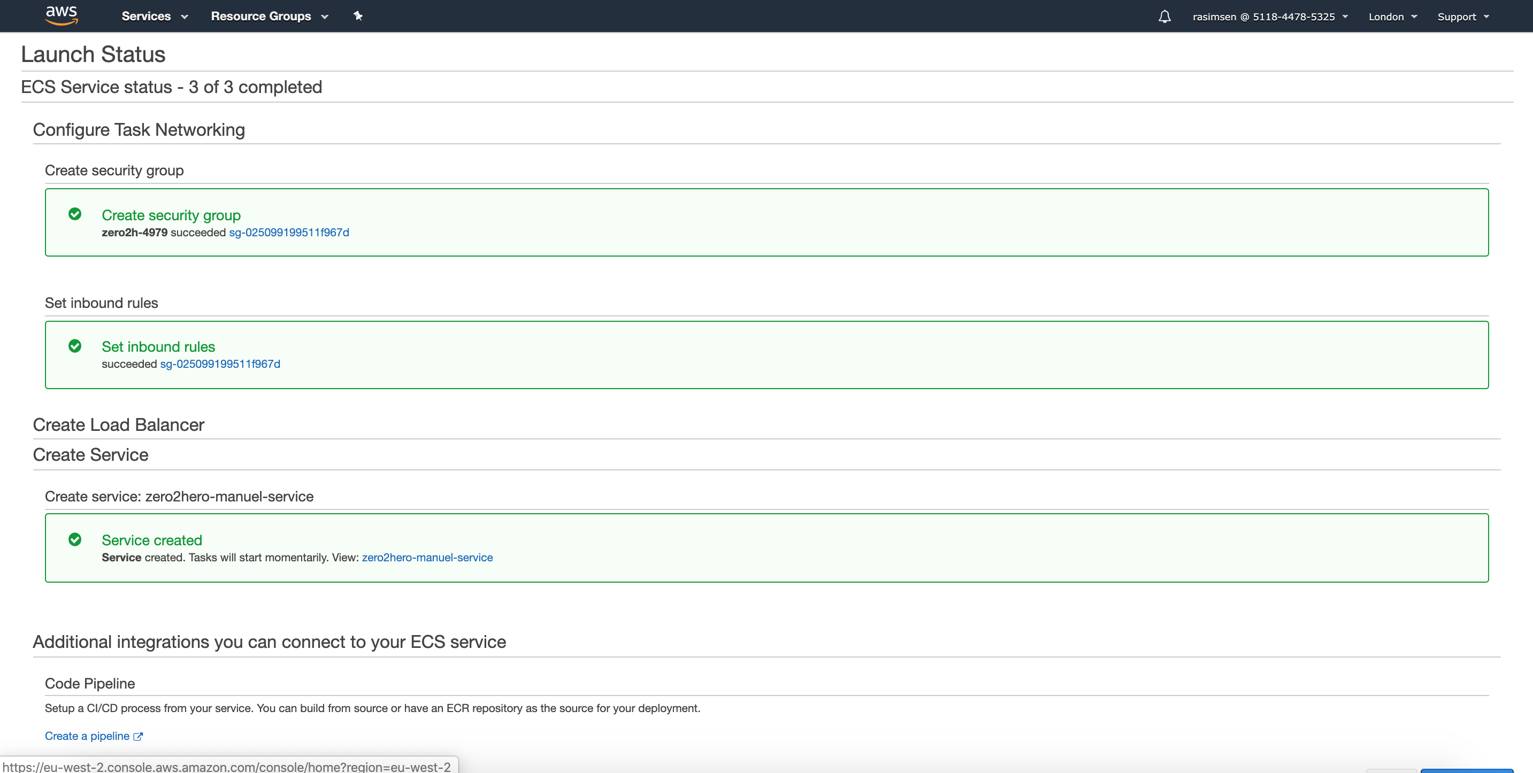
Launch Status

Slide 49
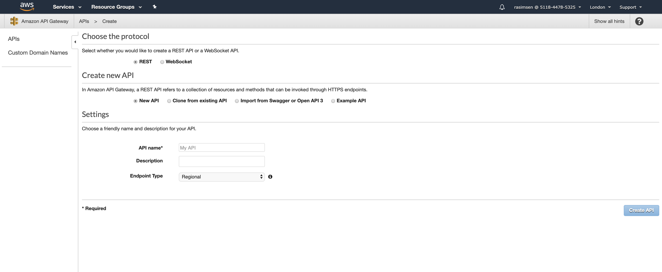
Api Gateway

Slide 50
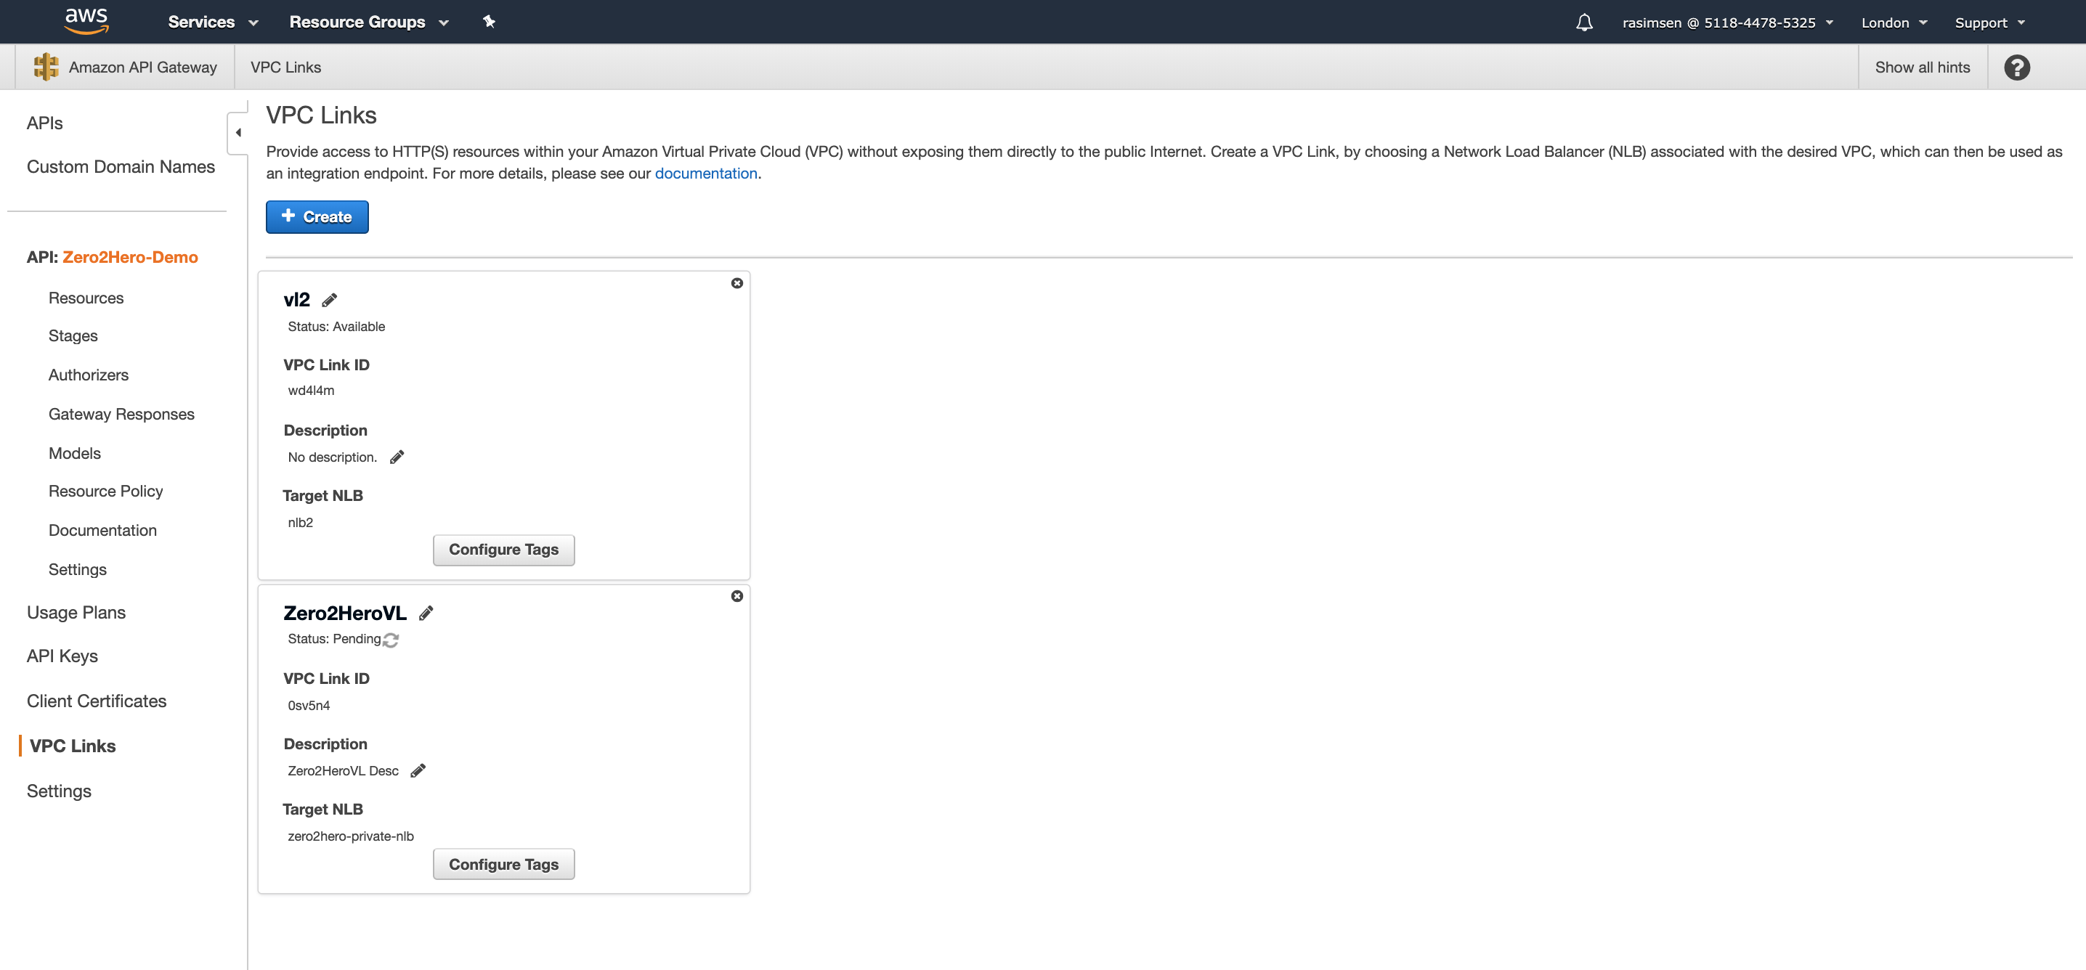
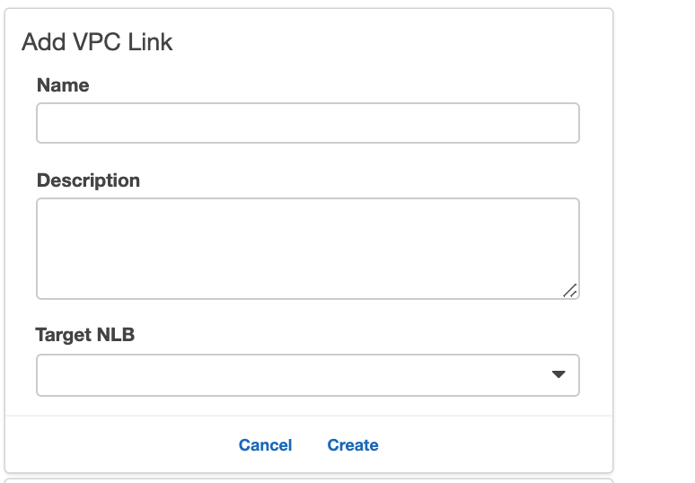
VPC Link

Slide 51
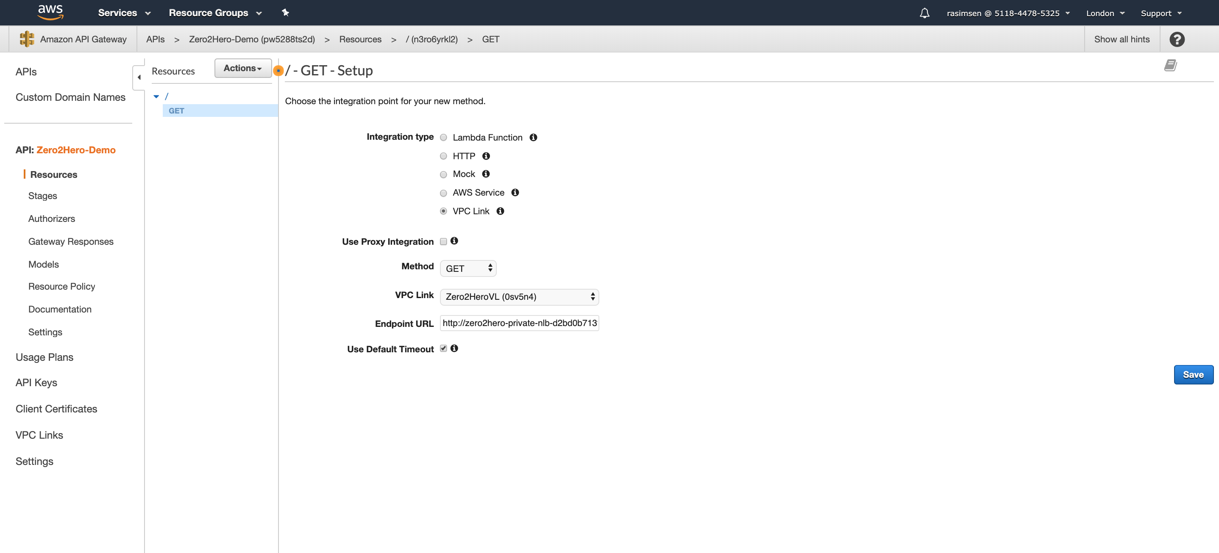
Endpoint Definition

Slide 52
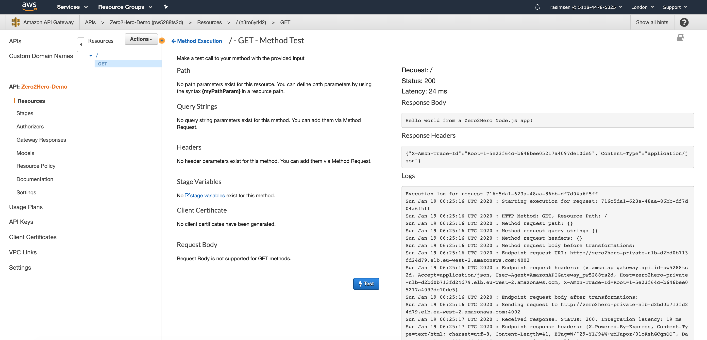
Endpoint Test

Slide 53
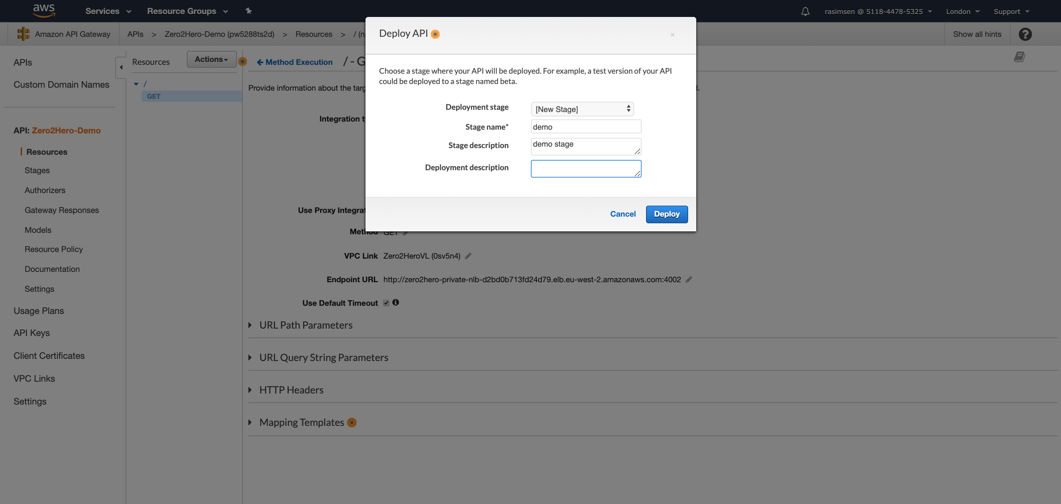
Api Gateway Deploy

Slide 54
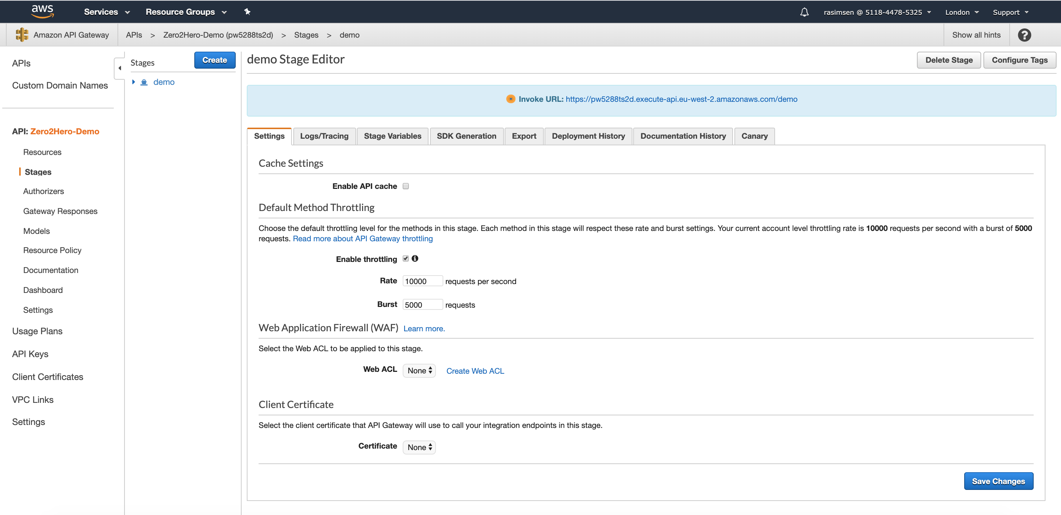
Stage Editor

Slide 55
Thank you!
Rasim SEN
Email : r@z2h.it

